Slide 1

Deadlock
Lecturer: VU THI MY HANG
Operating System

Slide 2
Plan
Introduction to Deadlock
Deadlock Handling

Slide 3
Plan
Introduction to Deadlock
Deadlock Handling

Slide 4
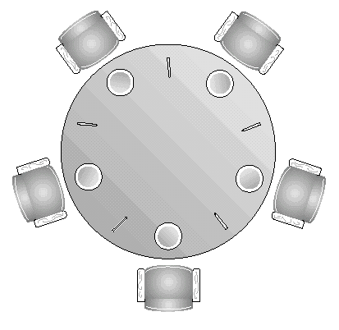
Recall: Dining-Philosophers Problem
Introduction to Deadlock
semaphore forks[5];
Philosopher (int i) {//i: philosopher number
while(true) {
down(forks[i]); //take left fork
down(forks[(i + 1)%5]); //take right fork
eating( );
up(forks[i]); //put left fork back
up(forks[(i + 1)%5]); //put right fork back
}
}
☹ Deadlock

Slide 5
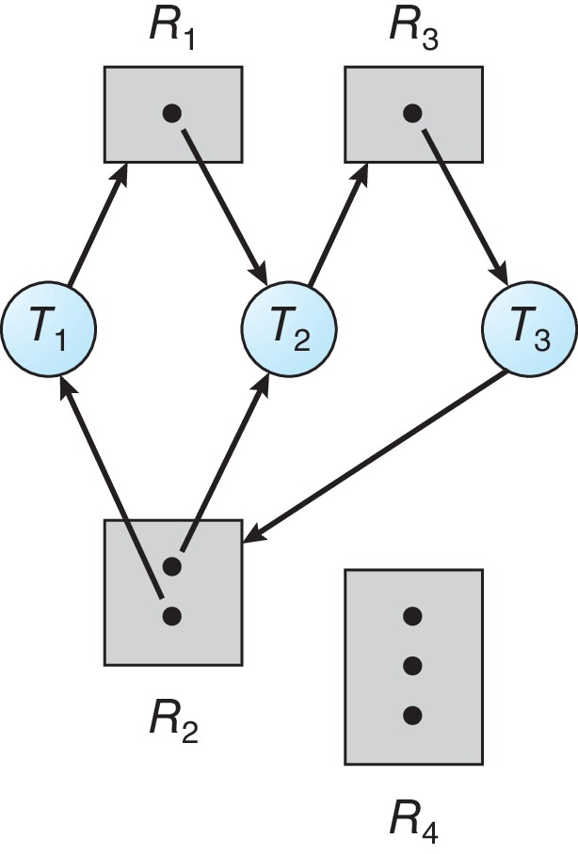
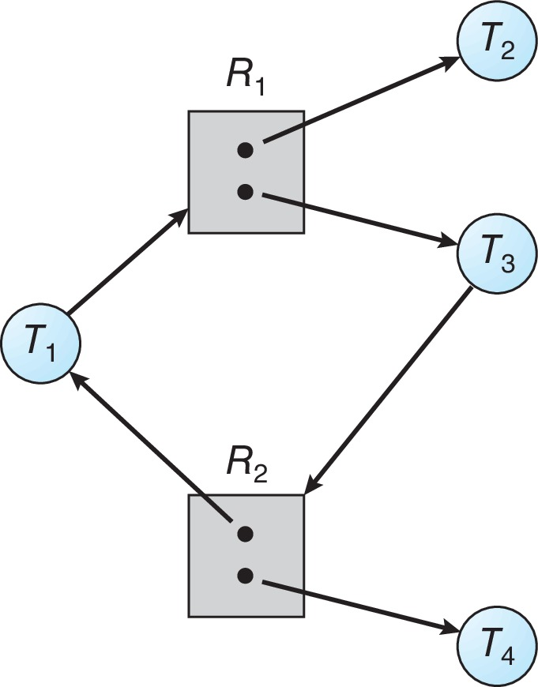
Resource-Allocation Graph (RAG)
Introduction to Deadlock
Resource R3 has one instance
Process T3 holds one instance of R3 and requests one instance of R2
Resource R4 has three instances
☹ Deadlock
☺ No Deadlock

Slide 6
Resource-Allocation Graph (RAG)
Introduction to Deadlock
Graph with no cycle
→ no deadlock
Graph with a cycle and resources having only one instance
→ deadlock
Graph with a cycle and resources having various instances
→ deadlock possibility
☺ No Deadlock
☹ Deadlock
☺ No Deadlock

Slide 7
Deadlock Definition
Introduction to Deadlock
A set of processes is in a deadlock situation when each of them is waiting for resources allocated to other waiting processes in the set, therefore none of them can get all necessary resources to continue executing.

Slide 8
Conditions for Deadlock
Introduction to Deadlock
All four following conditions must take place to cause deadlock
Mutual Exclusion
Only one process can hold the resource at a time
Hold and Wait
Process holds some resources while waiting for others, which are held by other waiting processes
No preemption
A resource can be released only by the process holding it
Circular Wait
There is a wait-cycle between at least two processes

Slide 9
Plan
Introduction to Deadlock
Deadlock Handling
Ignorance
Prevention
Avoidance
Detection and Recovery

Slide 10
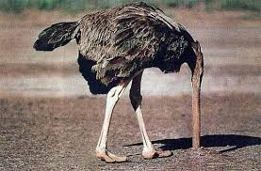
Deadlock Ignorance
Deadlock Handling
Ostrich Algorithm: pretend that deadlocks do not cause any problem
Deadlocks occur rarely
Deadlock handling is much more costly
Deadlock?
I don’t care ☺

Slide 11
Deadlock Prevention
Deadlock Handling
Eliminate the occurrence of one of the four conditions causing deadlocks
Mutual Exclusion
Not practical
Hold and Wait
Process must require all necessary resources when starting executing
Or release currently holding resources before requesting others
Difficult to know all necessary resources at the beginning
Low resource utilization
Starvation possibility

Slide 12
Deadlock Prevention (cont.)
Deadlock Handling
Eliminate the occurrence of one of the four conditions causing deadlocks
No preemption
OS may preempt resources from a process in some circumstance
☹ May cause errors for some resources (e.g., printer, files)
Circular Wait
Allocate different resource types according to a priority order

Slide 13
Deadlock Avoidance
Deadlock Handling
Test deadlock possibility before granting resources to avoid a future deadlock
OS requires processes to provide additional information (e.g., maximum requirement) to decide on resource allocation
Whenever a process requests a resource, OS tests deadlock possibility by using deadlock avoidance algorithms
If a resource request may lead to a future deadlock, the resource can NOT BE GRANTED
One instance of resource type: RAG
Multiple instances of resource type: Banker’s algorithm

Slide 14
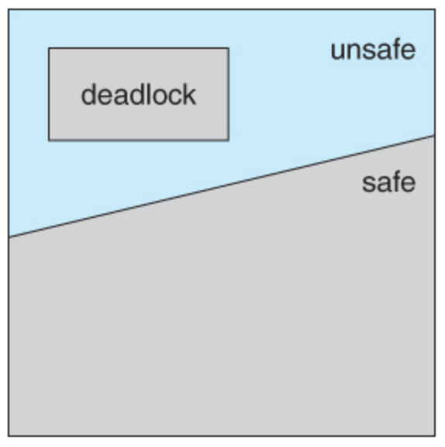
Deadlock Avoidance (cont.)
Deadlock Handling
Safe state: no deadlock
System is safe if there exists a safe sequence for resource allocation
All resource requests will be granted without entering a deadlock situation
Unsafe state: may lead to deadlock
Deadlock avoidance: ensure that the system will be in a safe state after resource allocation

Slide 15
Deadlock Avoidance (cont.)
Deadlock Handling
Banker’s algorithm
Also referred to as safety algorithm, developed by Edsger Dijkstra
Notions used in Banker’s algorithm
Available: available resources
Max: maximum resource requirements of each process
Allocation: resources allocated to each process
Need: remaining resources needed for each process
Need = Max – Allocation
Request: resource request chain of a process
For a request, test if the system will be in a safe state

Slide 16

Deadlock Avoidance (cont.)
Deadlock Handling
Example of Banker’s algorithm
 | Allocation
 | C | D | E
P₀ | 0 | 1 | 0
P₁ | 2 | 0 | 0
P₂ | 3 | 0 | 2
P₃ | 2 | 1 | 1
P₄ | 0 | 0 | 2
Max |  | Request (Claim)
C | D | E
7 | 5 | 3
3 | 2 | 2
9 | 0 | 2
2 | 2 | 2
4 | 3 | 3
Need |  | Request (Claim)
C | D | E
Available (Work)
C | D | E
3 | 3 | 2
7 | 4 | 3
7 | 4 | 3
1 | 2 | 2
6 | 0 | 0
0 | 1 | 1
4 | 3 | 1
10 | 5 | 7
The system is safe?
One possible safe sequence:
(P1, P3,
P0, P2, P4)

Slide 17
Deadlock Avoidance (cont.)
Deadlock Handling
Example of Banker’s algorithm
 | Allocation
 | C | D | E
P₀ | 0 | 1 | 0
P₁ | 2 | 0 | 0
P₂ | 3 | 0 | 2
P₃ | 2 | 1 | 1
P₄ | 0 | 0 | 2
Max |  | Request (Claim)
C | D | E
7 | 5 | 3
3 | 2 | 2
9 | 0 | 2
2 | 2 | 2
4 | 3 | 3
Need |  | Request (Claim)
C | D | E
Available (Work)
C | D | E
3 | 3 | 2
7 | 4 | 3
1 | 2 | 2
6 | 0 | 0
0 | 1 | 1
4 | 3 | 1
Request_{P1} = (1, 0, 2) will be granted safely?
Request_{P1} < Need_{P1} < Available
➔ Request_{P1} granted ➔ Update Allocation_{P1}, Need_{P1}, Available

Slide 18
Deadlock Avoidance (cont.)
Deadlock Handling
Example of Banker’s algorithm
 | Allocation
 | C | D | E
P₀ | 0 | 1 | 0
P₁ | 3 | 0 | 2
P₂ | 3 | 0 | 2
P₃ | 2 | 1 | 1
P₄ | 0 | 0 | 2
Max |  | Request (Claim)
C | D | E
7 | 5 | 3
3 | 2 | 2
9 | 0 | 2
2 | 2 | 2
4 | 3 | 3
Need |  | Request (Claim)
C | D | E
Available (Work)
C | D | E
2 | 3 | 0
7 | 4 | 3
0 | 2 | 0
6 | 0 | 0
0 | 1 | 1
4 | 3 | 1
One possible safe sequence:
(P1, P3, P0, P2, P4)
Request_{P1} = (1, 0, 2) will be granted safely?
Request_{P1} < Need_{P1} < Available
➔ Request_{P1} granted ➔ Update Allocation_{P1}, Need_{P1}, Available

Slide 19
Deadlock Detection and Recovery
Deadlock Handling
Allow deadlock occurrence and then recover the system
Deadlock Detection
One instance of resource type: wait-for graph (i.e., a variation of RAG)
Multiple instances of resource type: matrix-based detection algorithm (also referred to as a variation of Banker’s algorithm)
Recovery
Terminate deadlocked processes
Rollback system to the previous safe checkpoint
Preempt resources

Slide 20
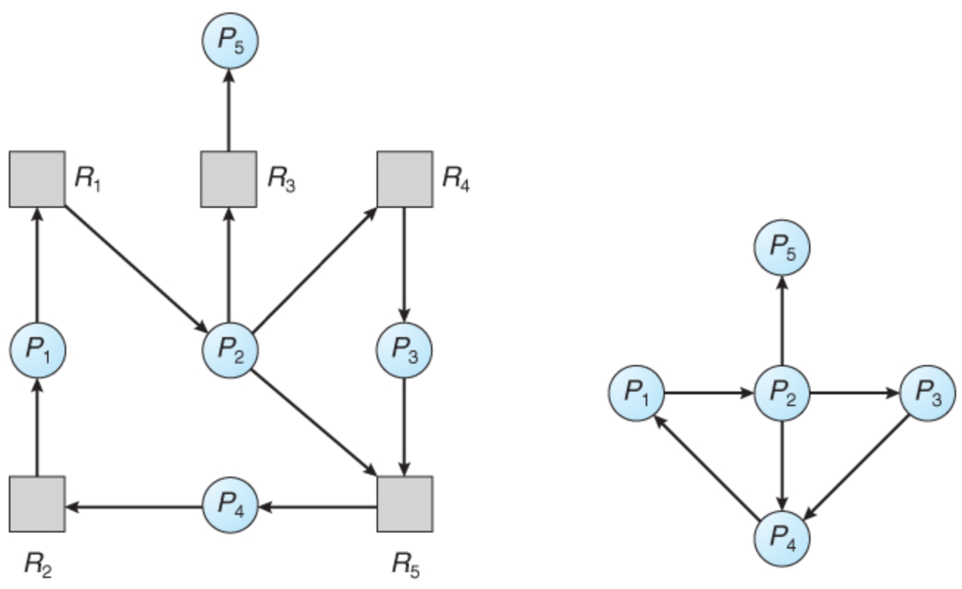
Deadlock Detection and Recovery (cont.)
Deadlock Handling
Example of using a wait-for graph to detect deadlocks
Cycles existing in the wait-for graph
→ deadlock detected
Resource-Allocation Graph
Wait-For Graph

Slide 21
Deadlock Detection and Recovery (cont.)
Deadlock Handling
Example of using matrix-based detection algorithm
 | Allocation
 | C | D | E
P₀ | 0 | 1 | 0
P₁ | 2 | 0 | 0
P₂ | 3 | 0 | 2
P₃ | 2 | 1 | 1
P₄ | 0 | 0 | 2
Request (Claim) |  | Request (Claim)
C | D | E
7 | 5 | 3
3 | 2 | 2
9 | 0 | 2
2 | 2 | 2
4 | 3 | 3
Available
C | D | E
3 | 3 | 2
7 | 4 | 5
Finish
P₀ | P₁ | P₂ | P₃ | P₄
0 | 0 | 0 | 0 | 0
0 | 1 | 0 | 1 | 1
P1, P3 and P4 can finish and release holding resources
☹ P0 and P2 could not finish → Deadlock detected

Slide 22

Topic 1

